Slide 1
Pyspark: Module-8

Slide 2
Pyspark| Transformation: Subtract vs ExceptAll

Slide 3
Subtract and exceptAll both are Pyspark Transformation used in Spark Development
These transformations create new dataframe by containing the rows from one Dataframe which are not present in second Dataframe
Subtract does not preserve duplicates while exceptAll preseves duplicates while creating new Dataframe

Slide 4
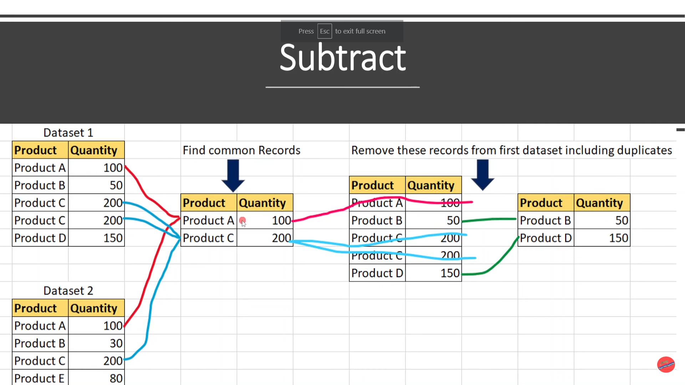

Slide 5
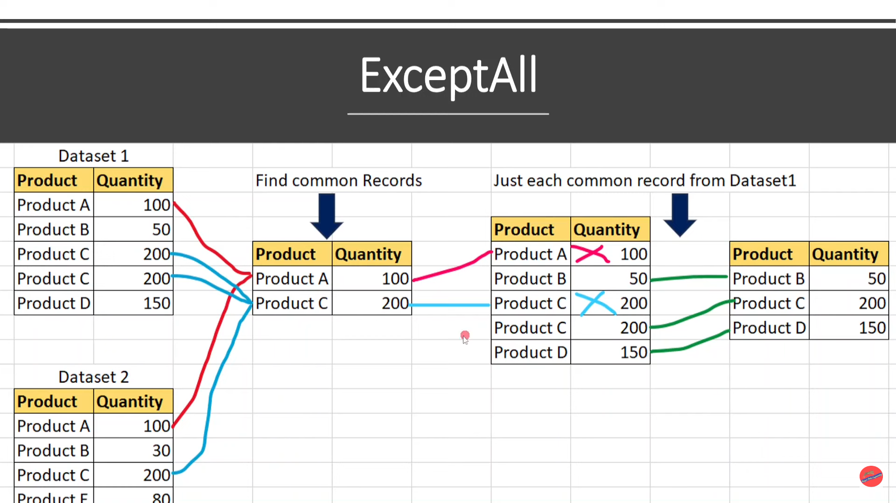

Slide 6
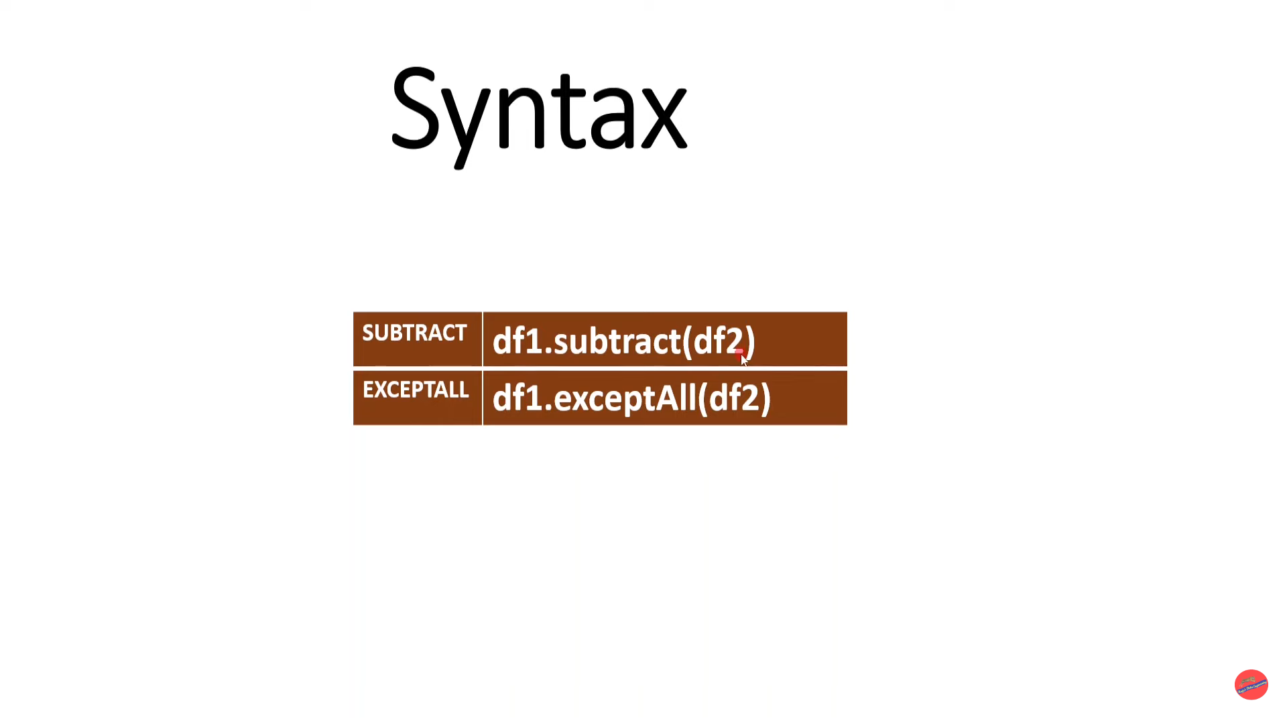

Slide 7
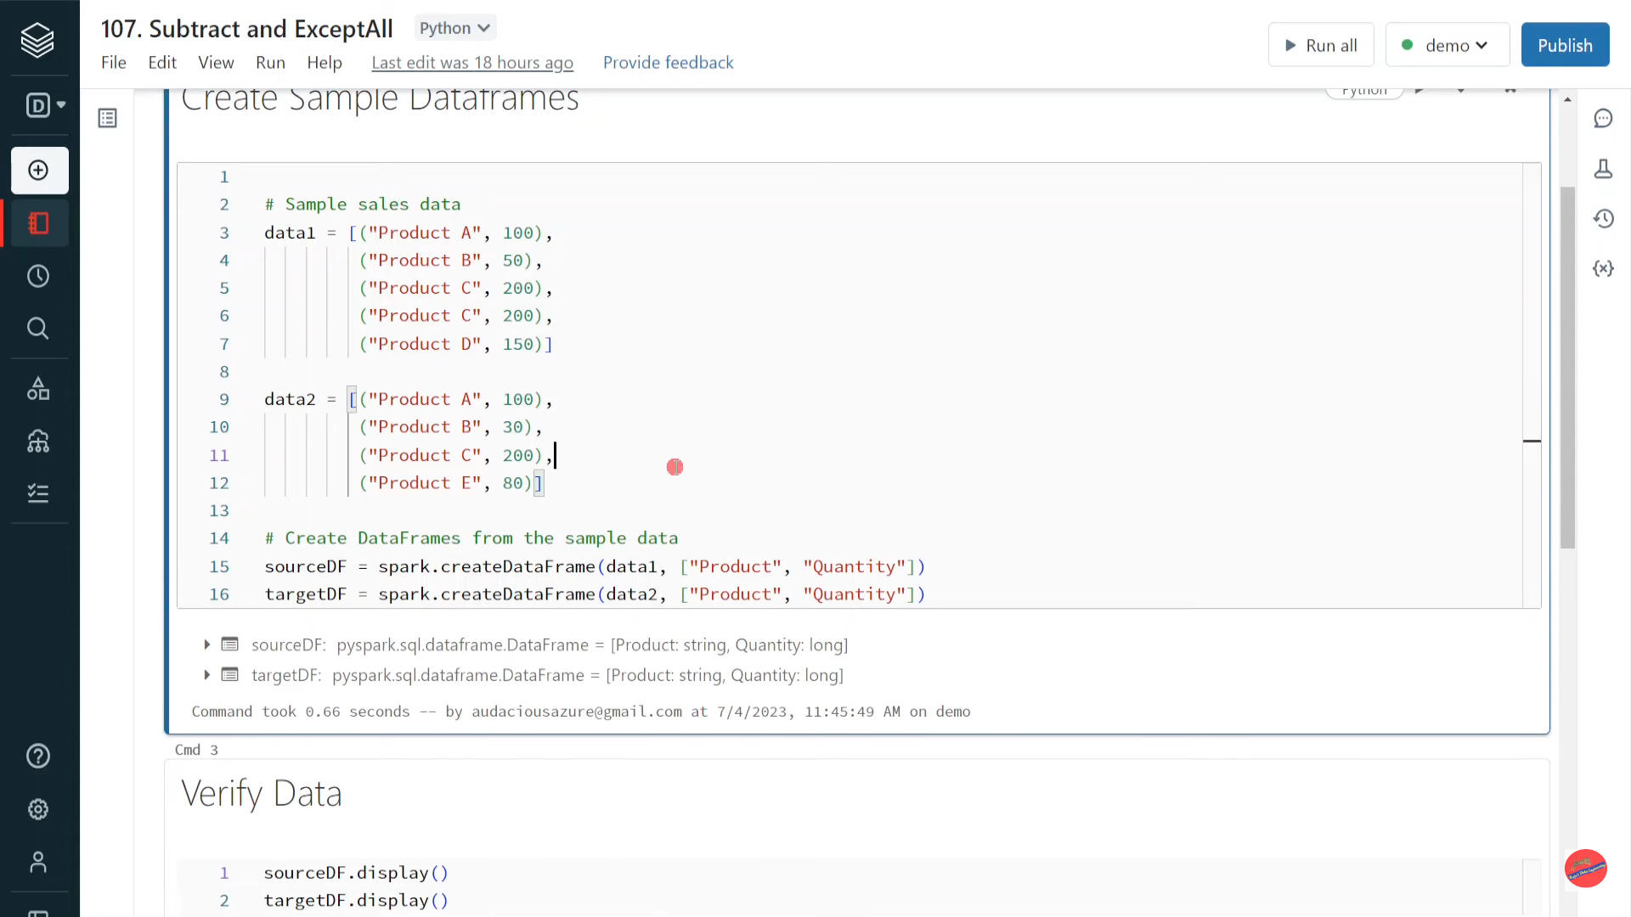

Slide 8
Databricks | Pyspark| Window Function: First and Last

Slide 9
Window functions are type of Pyspark transformation which creates window of records by grouping based on a key and apply certain logic within each window
First is one of Window function which returns first value of a column of each window
Last is one of Window function which returns last value of a column of each window

Slide 10
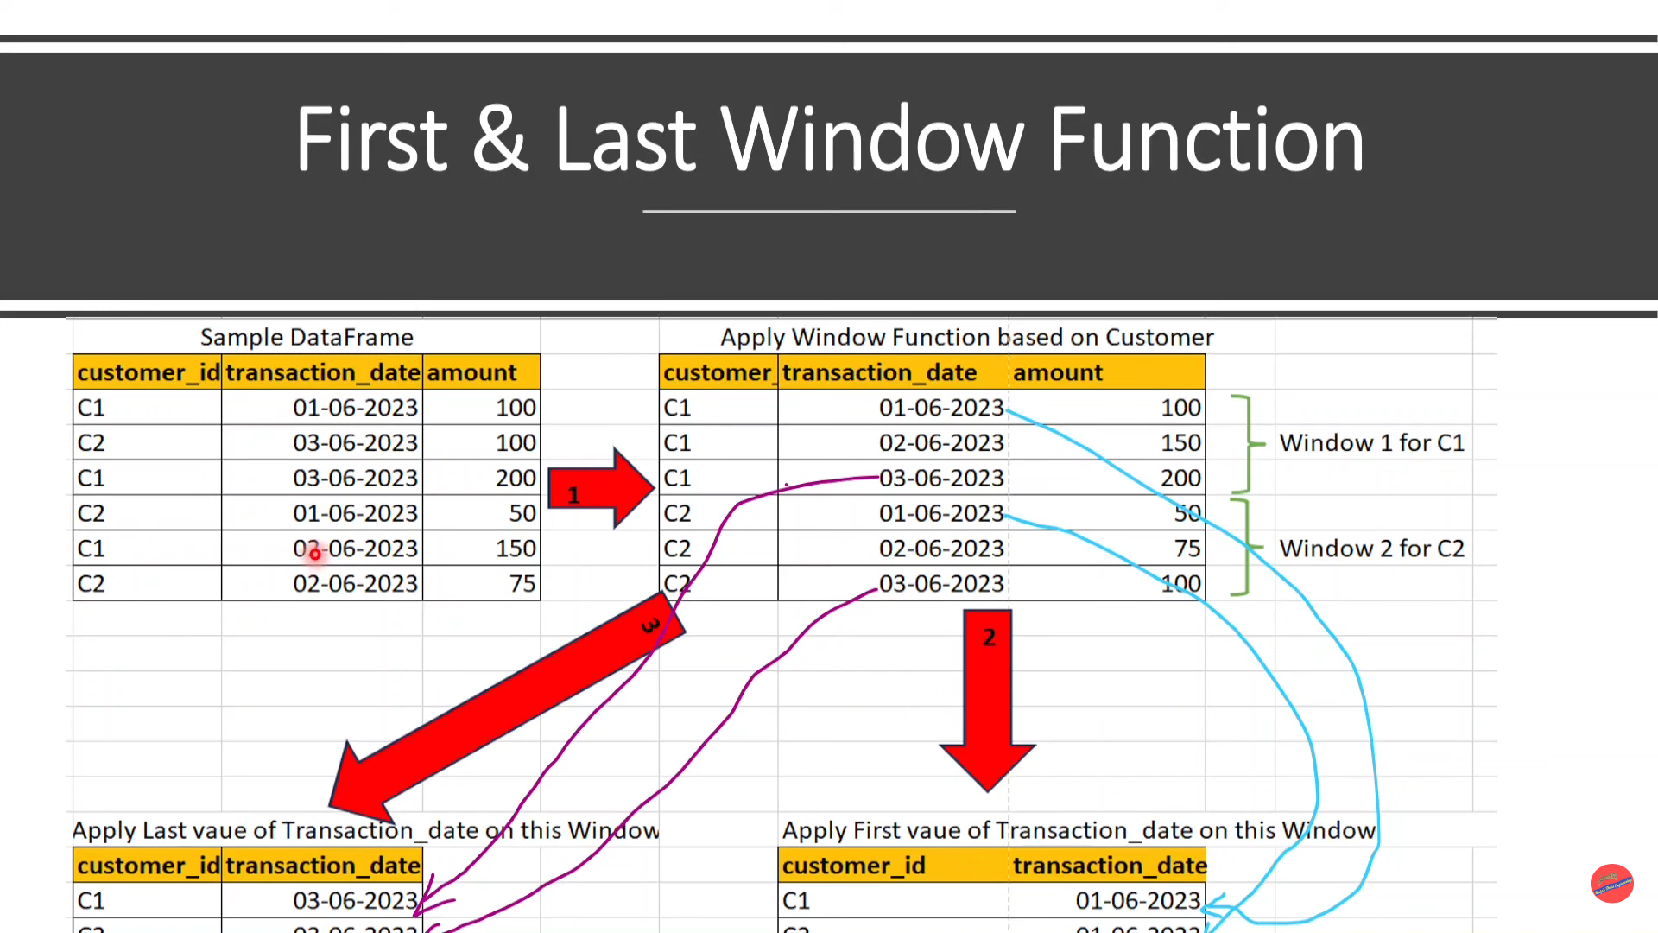

Slide 11
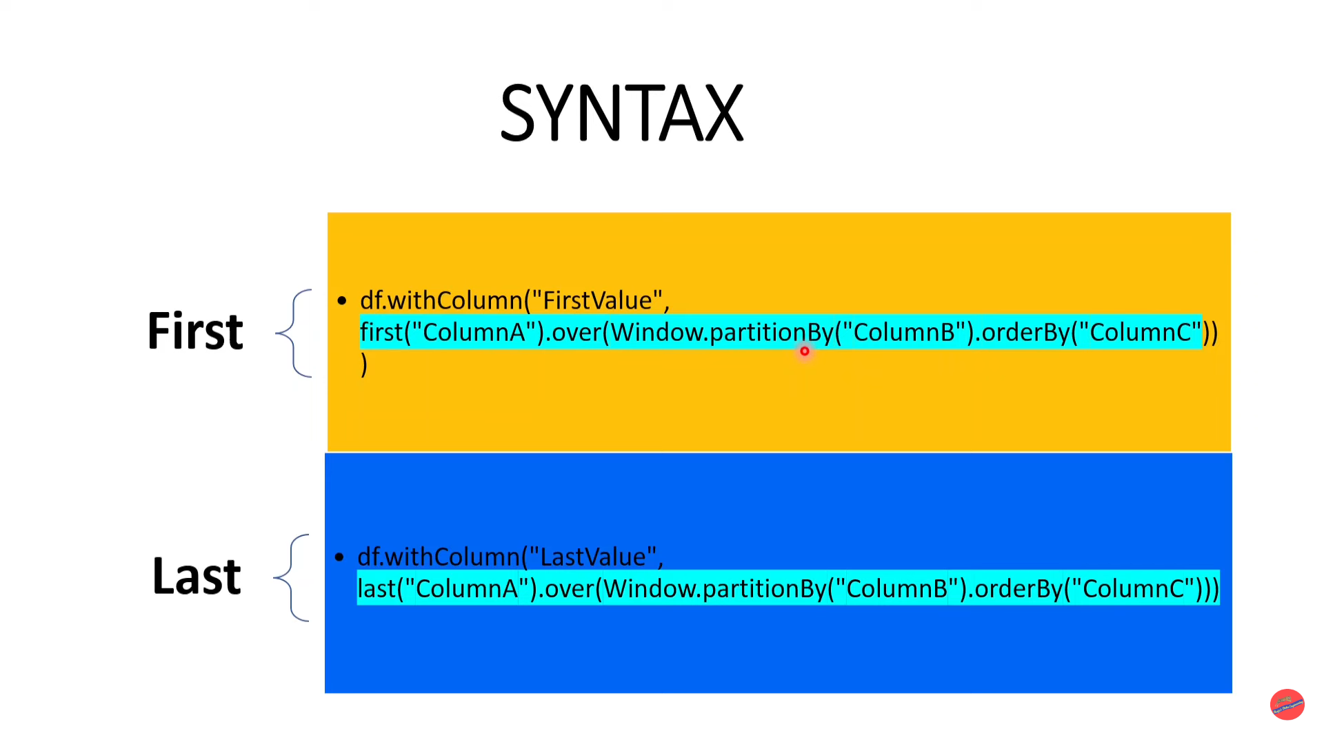

Slide 12
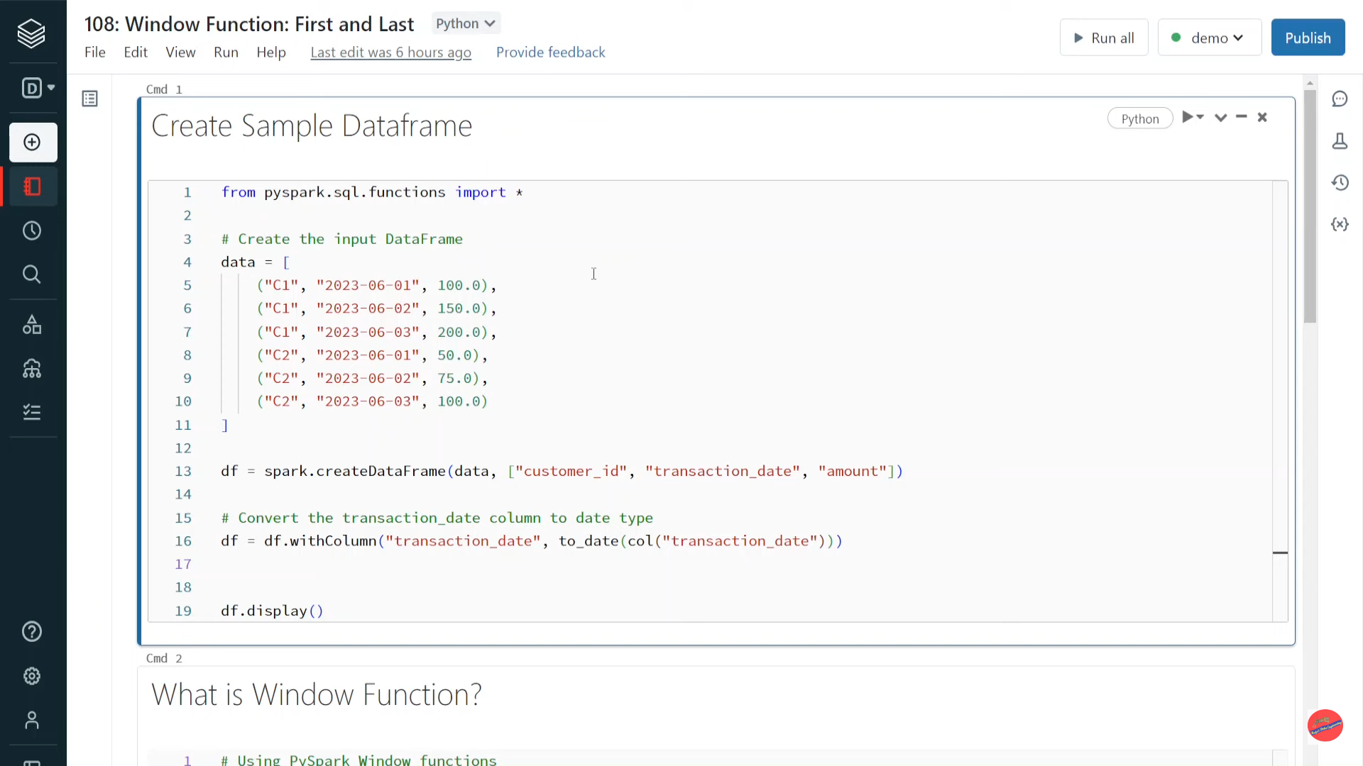

Slide 13
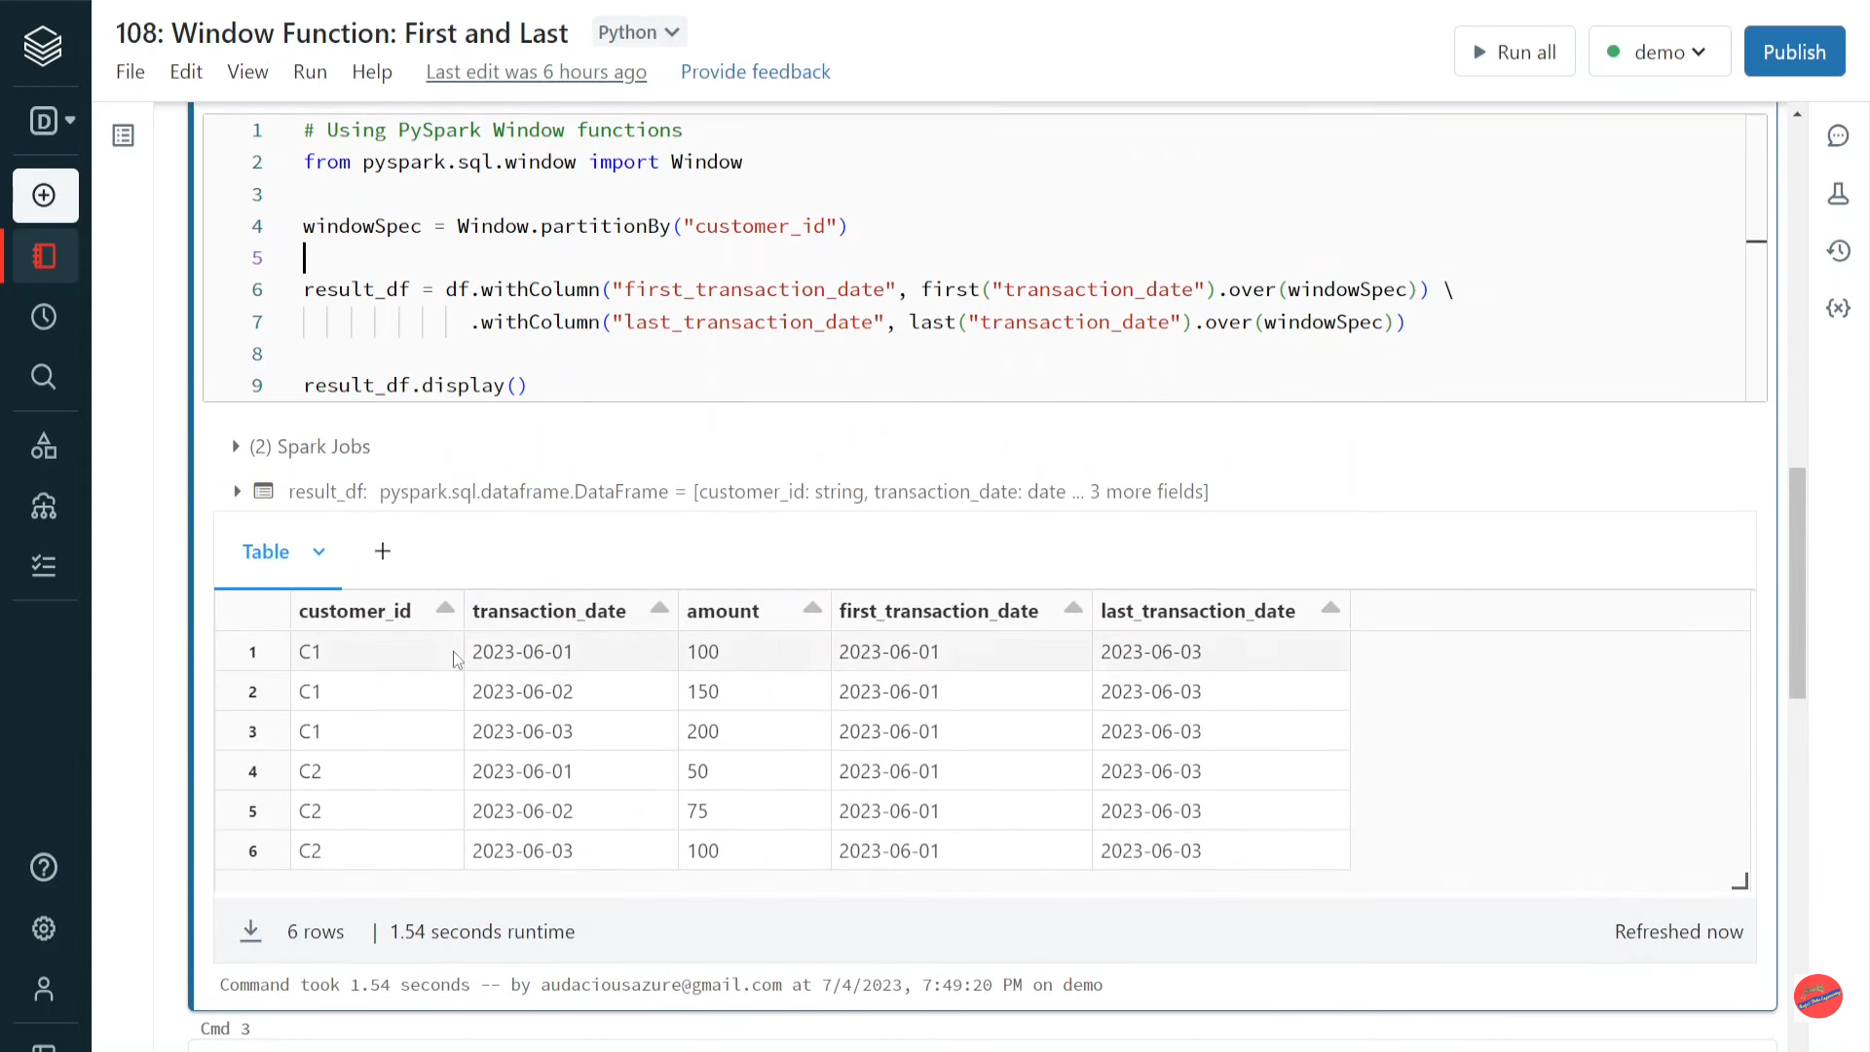

Slide 14
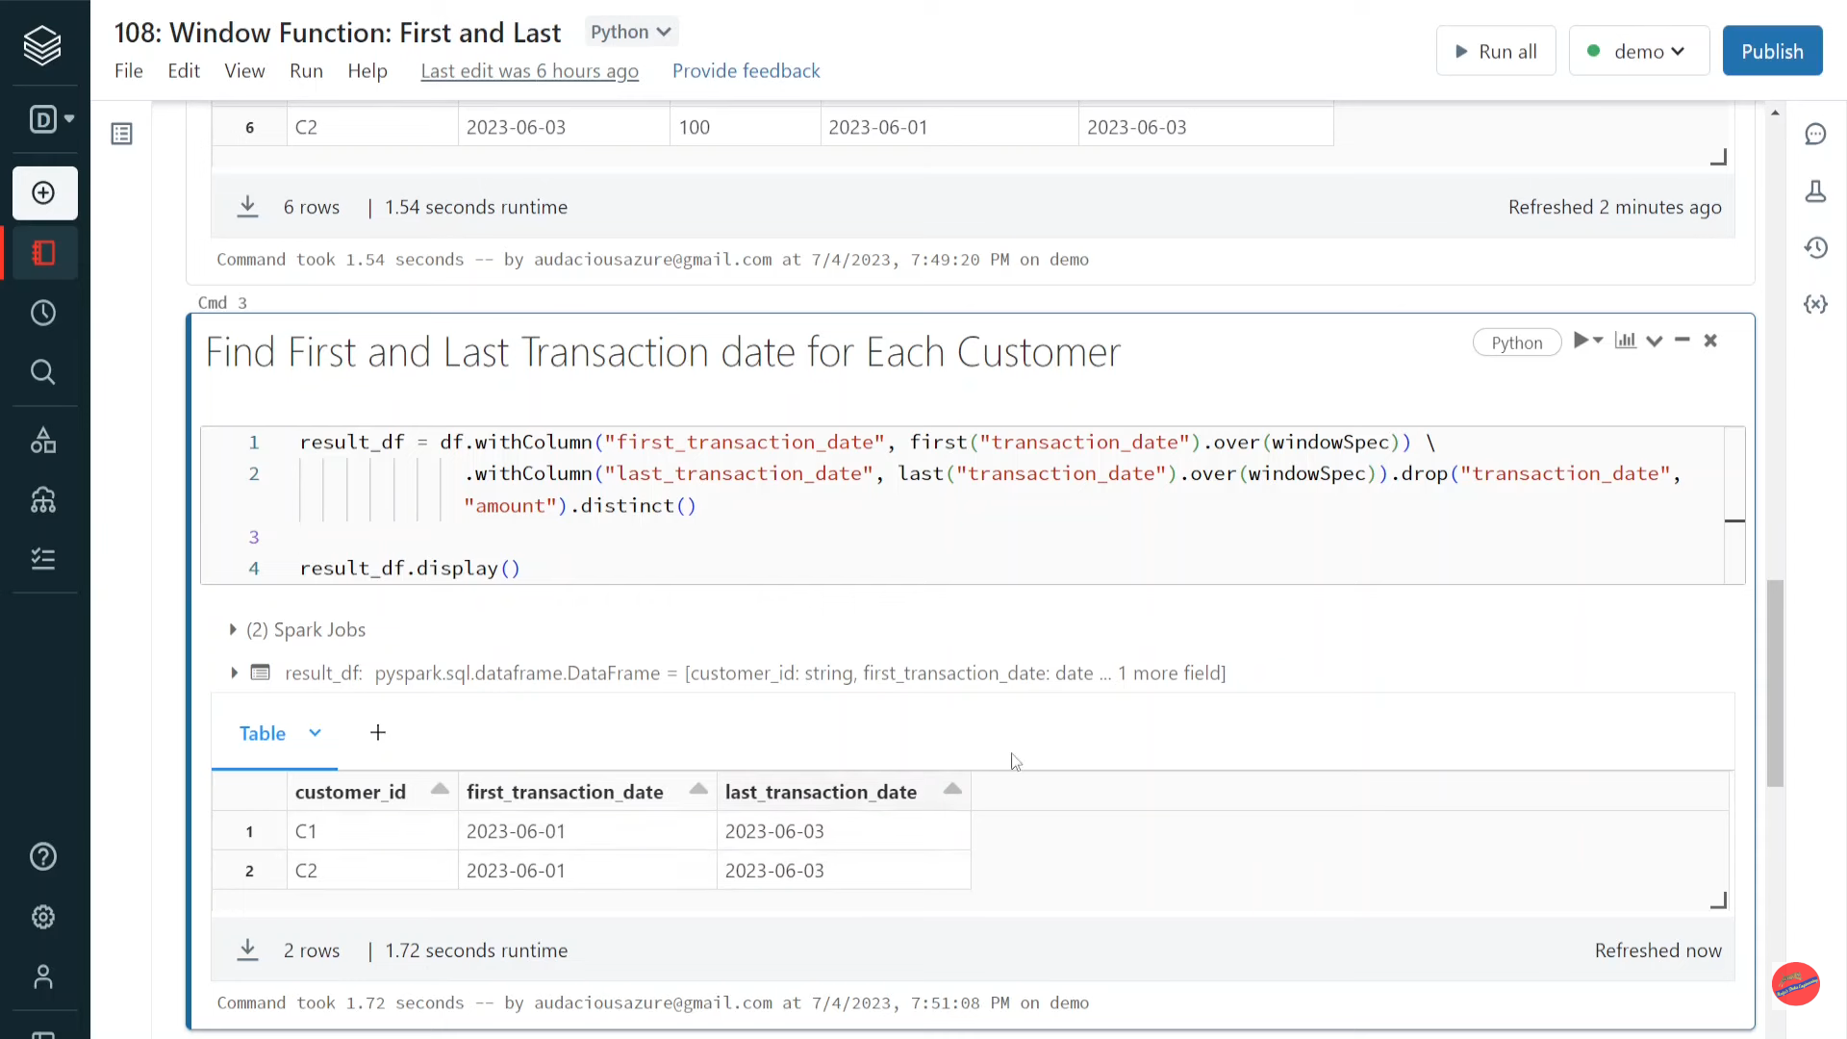

Slide 15
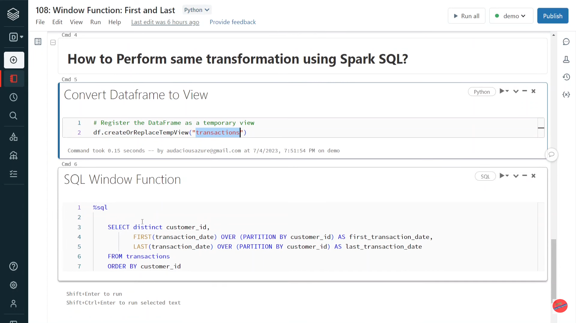

Slide 16
Databricks | Pyspark| Spark Reader: Skip First N Records While Reading CSV File

Slide 17
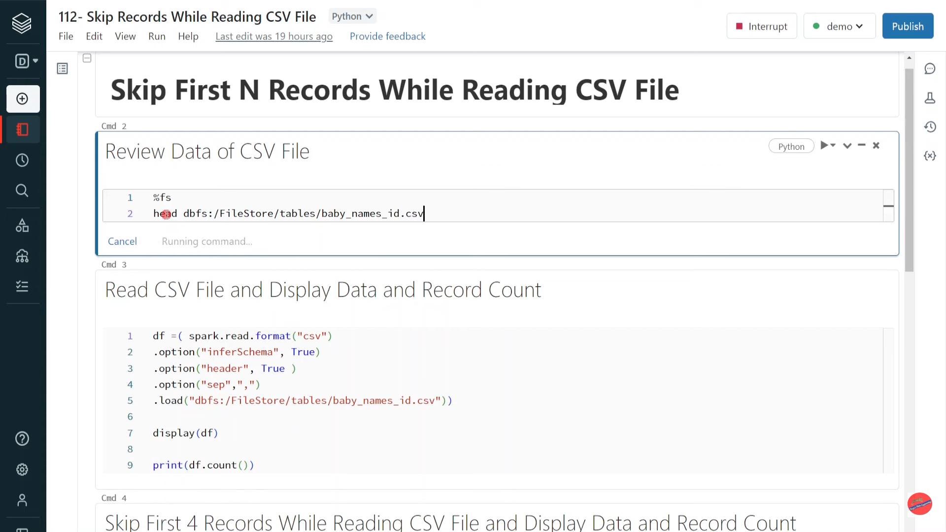

Slide 18
Databricks | PySpark| Spark Reader: Skip Specific Range of Records While Reading CSV File

Slide 19
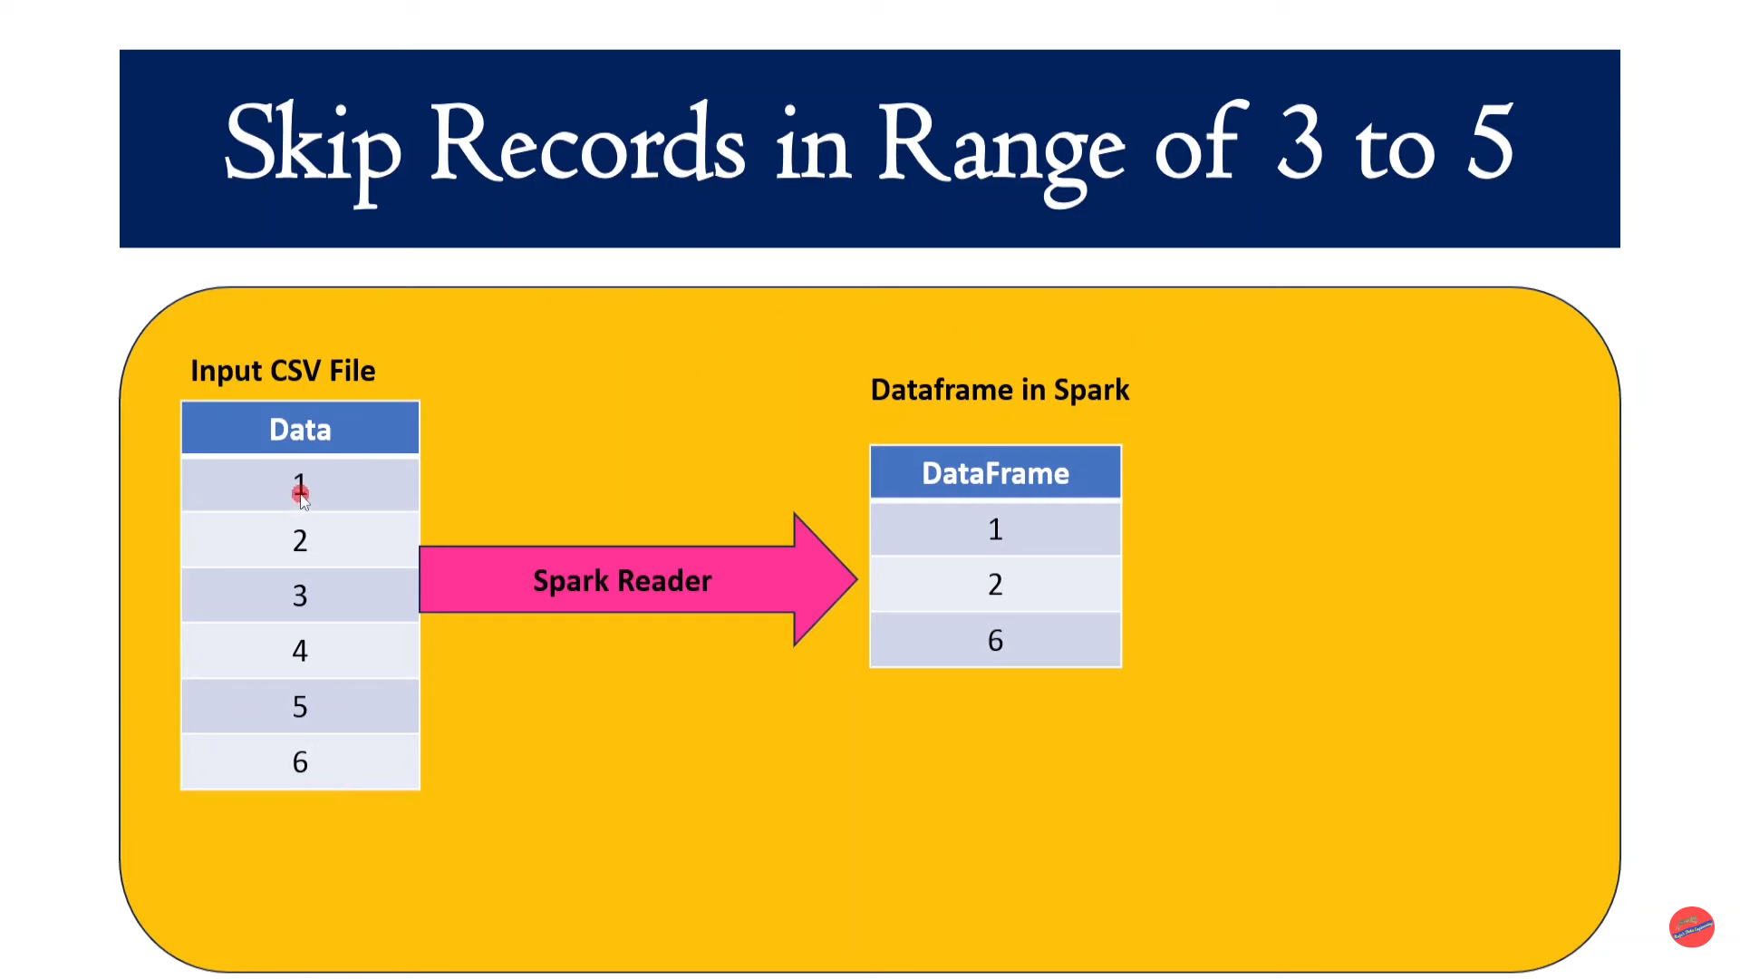

Slide 20
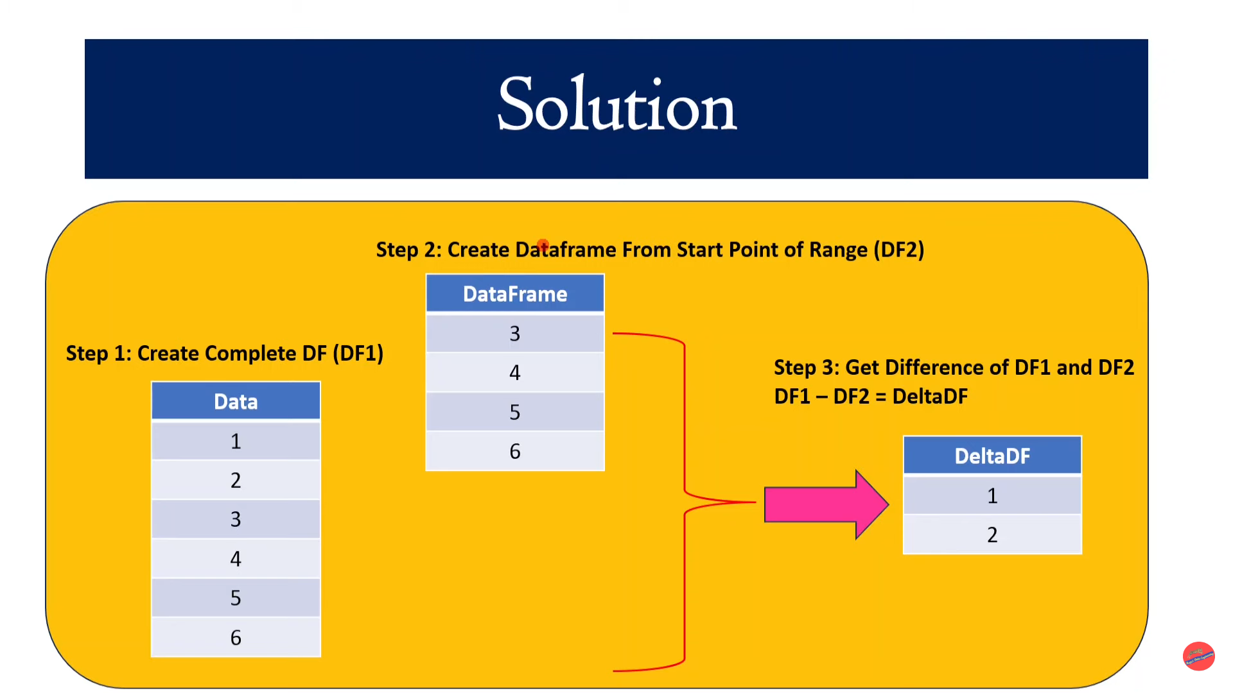

Slide 21
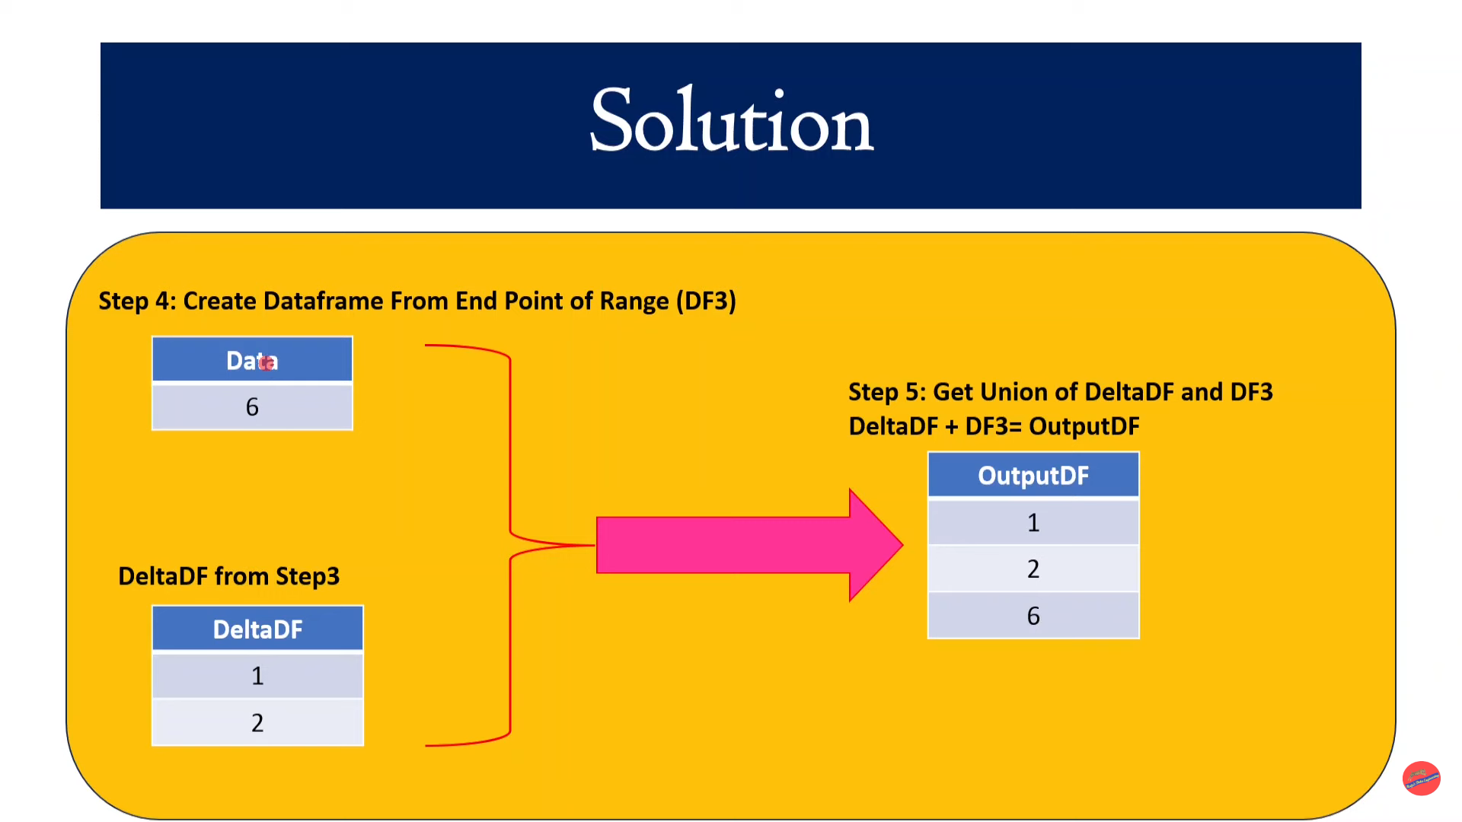

Slide 22
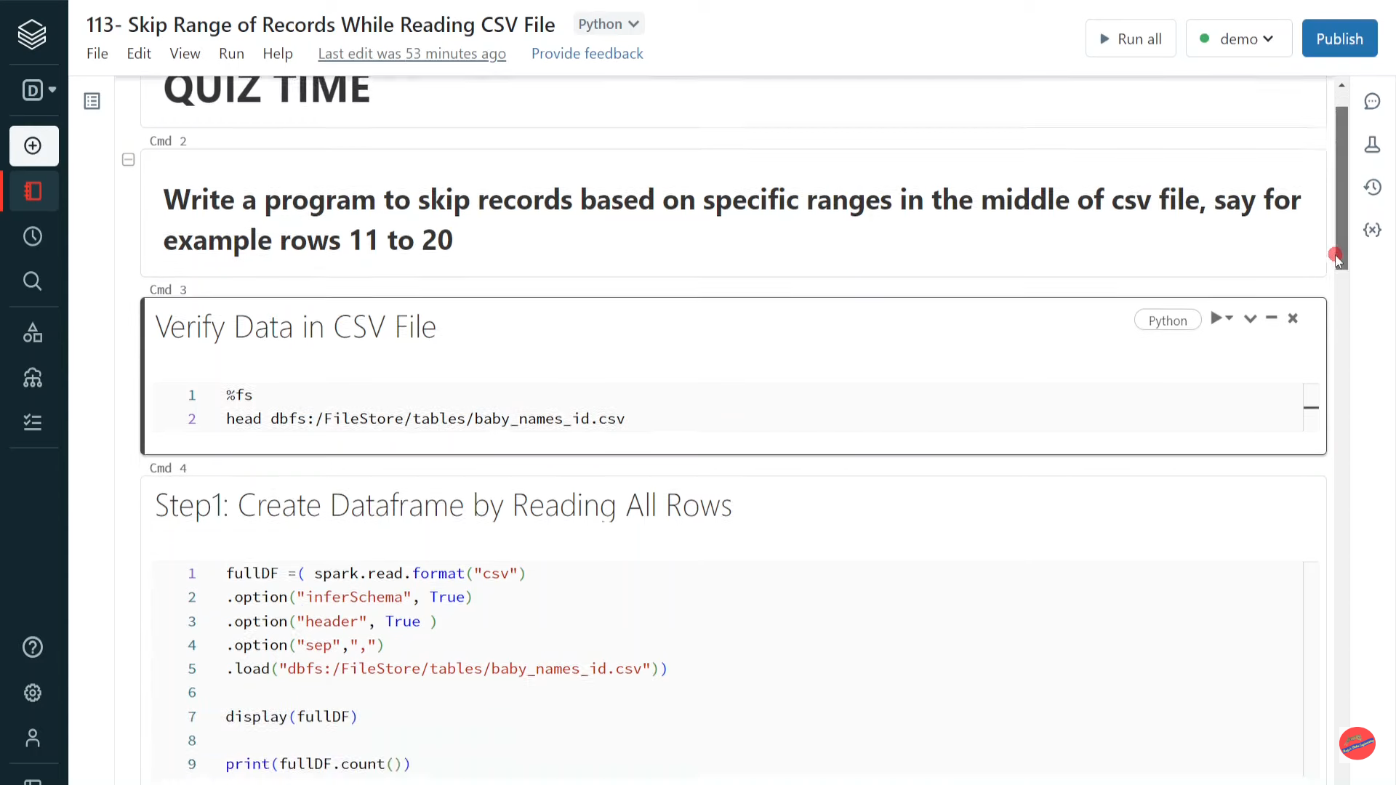

Slide 23
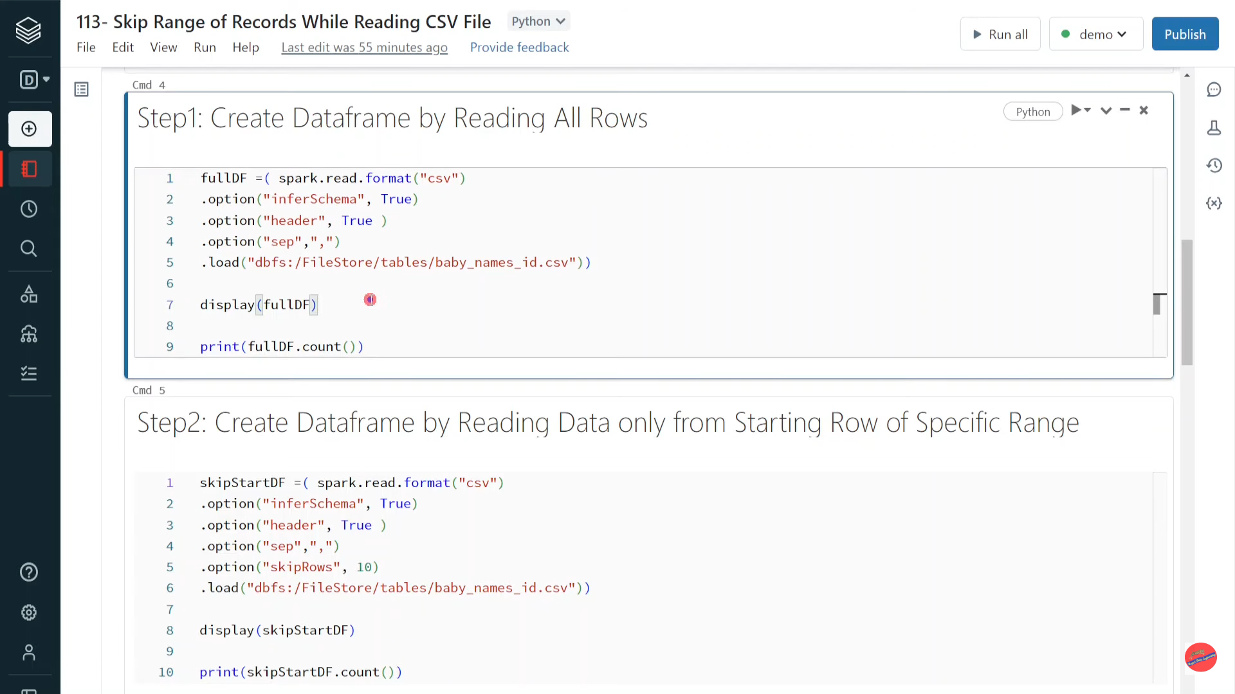

Slide 24
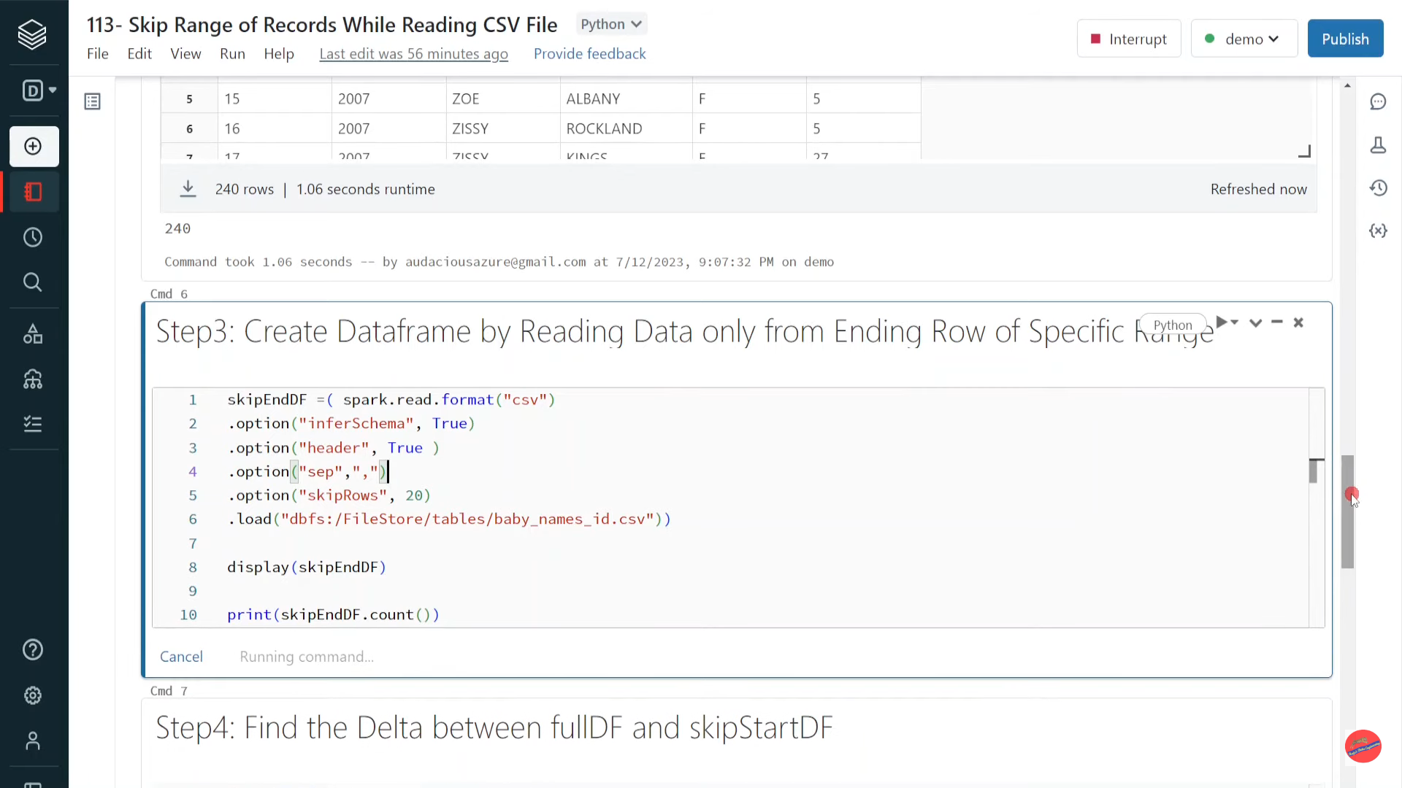

Slide 25
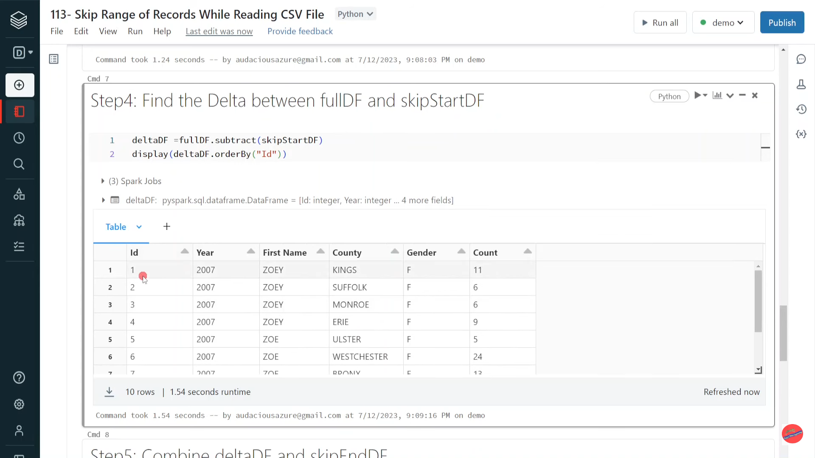

Slide 26
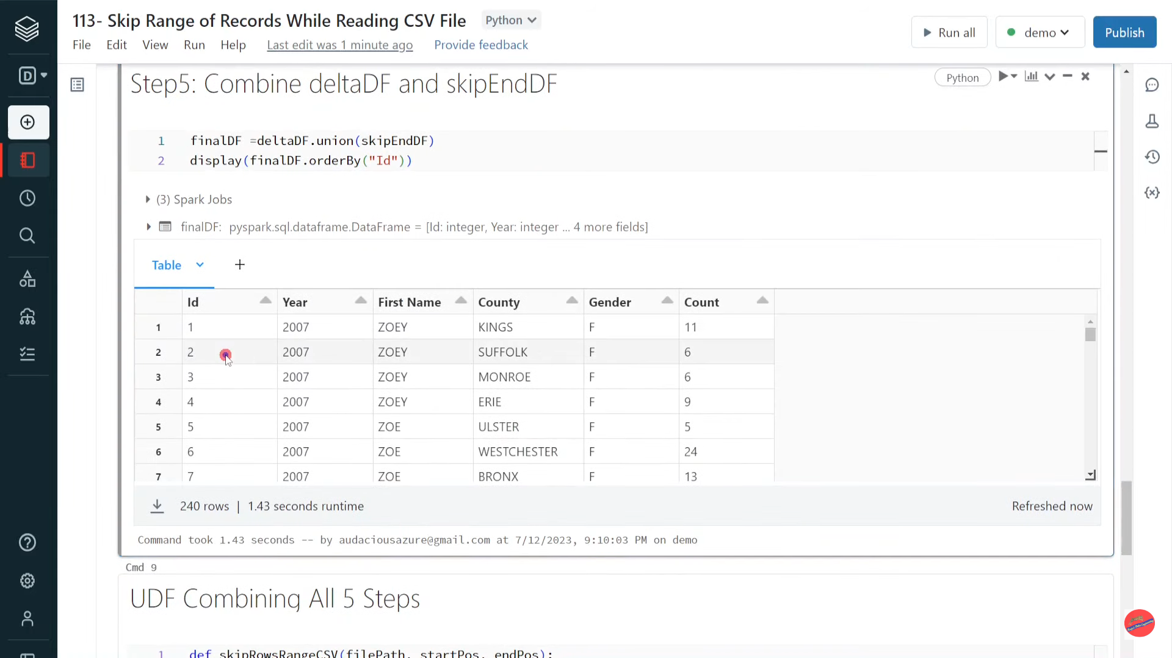

Slide 27
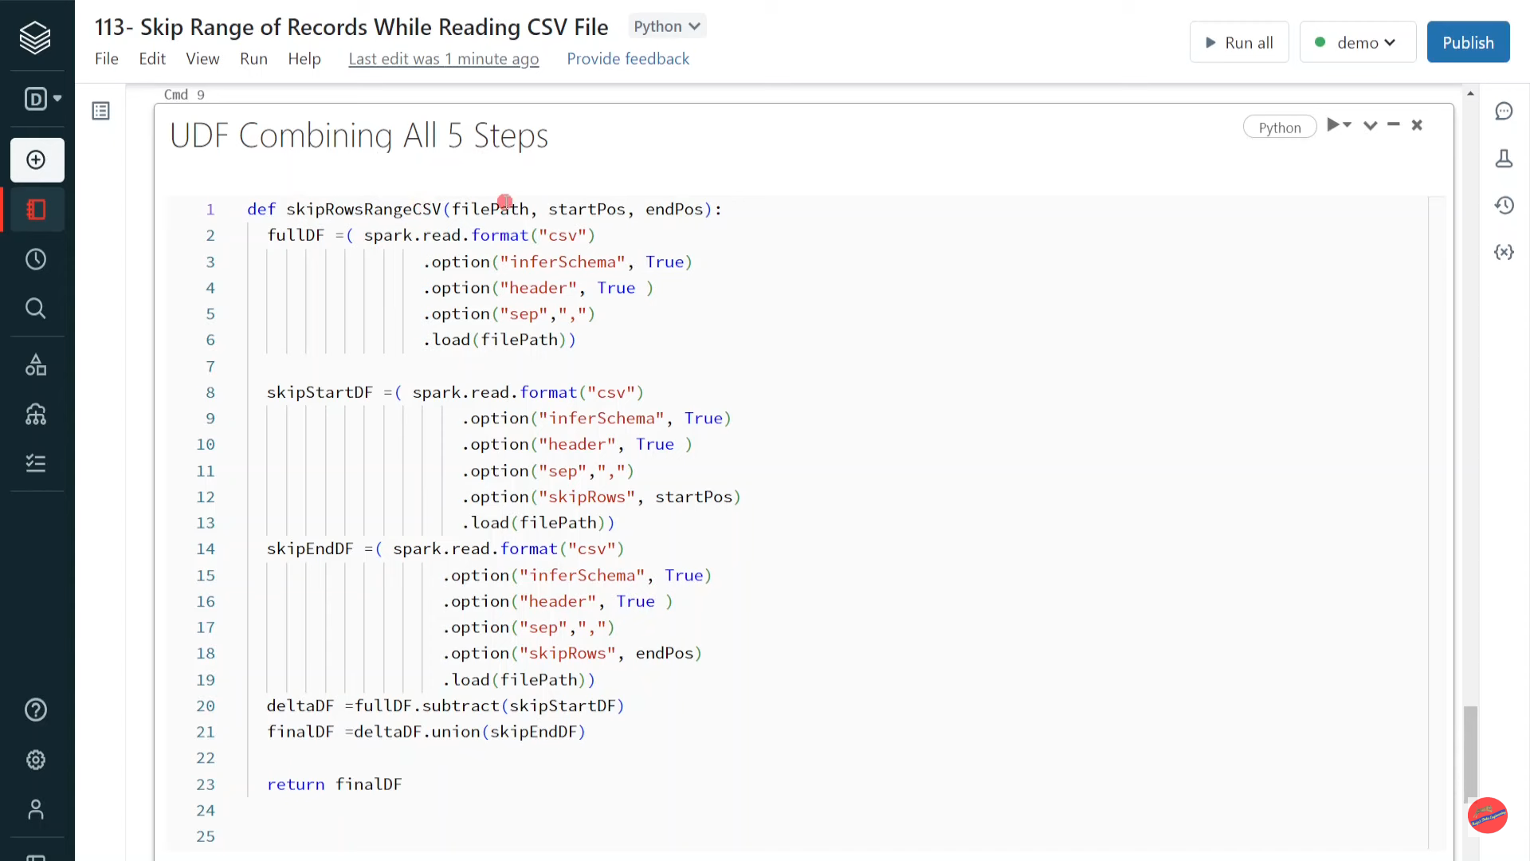

Slide 28
Pyspark| Query Dataframe Using Spark SQL

Slide 29
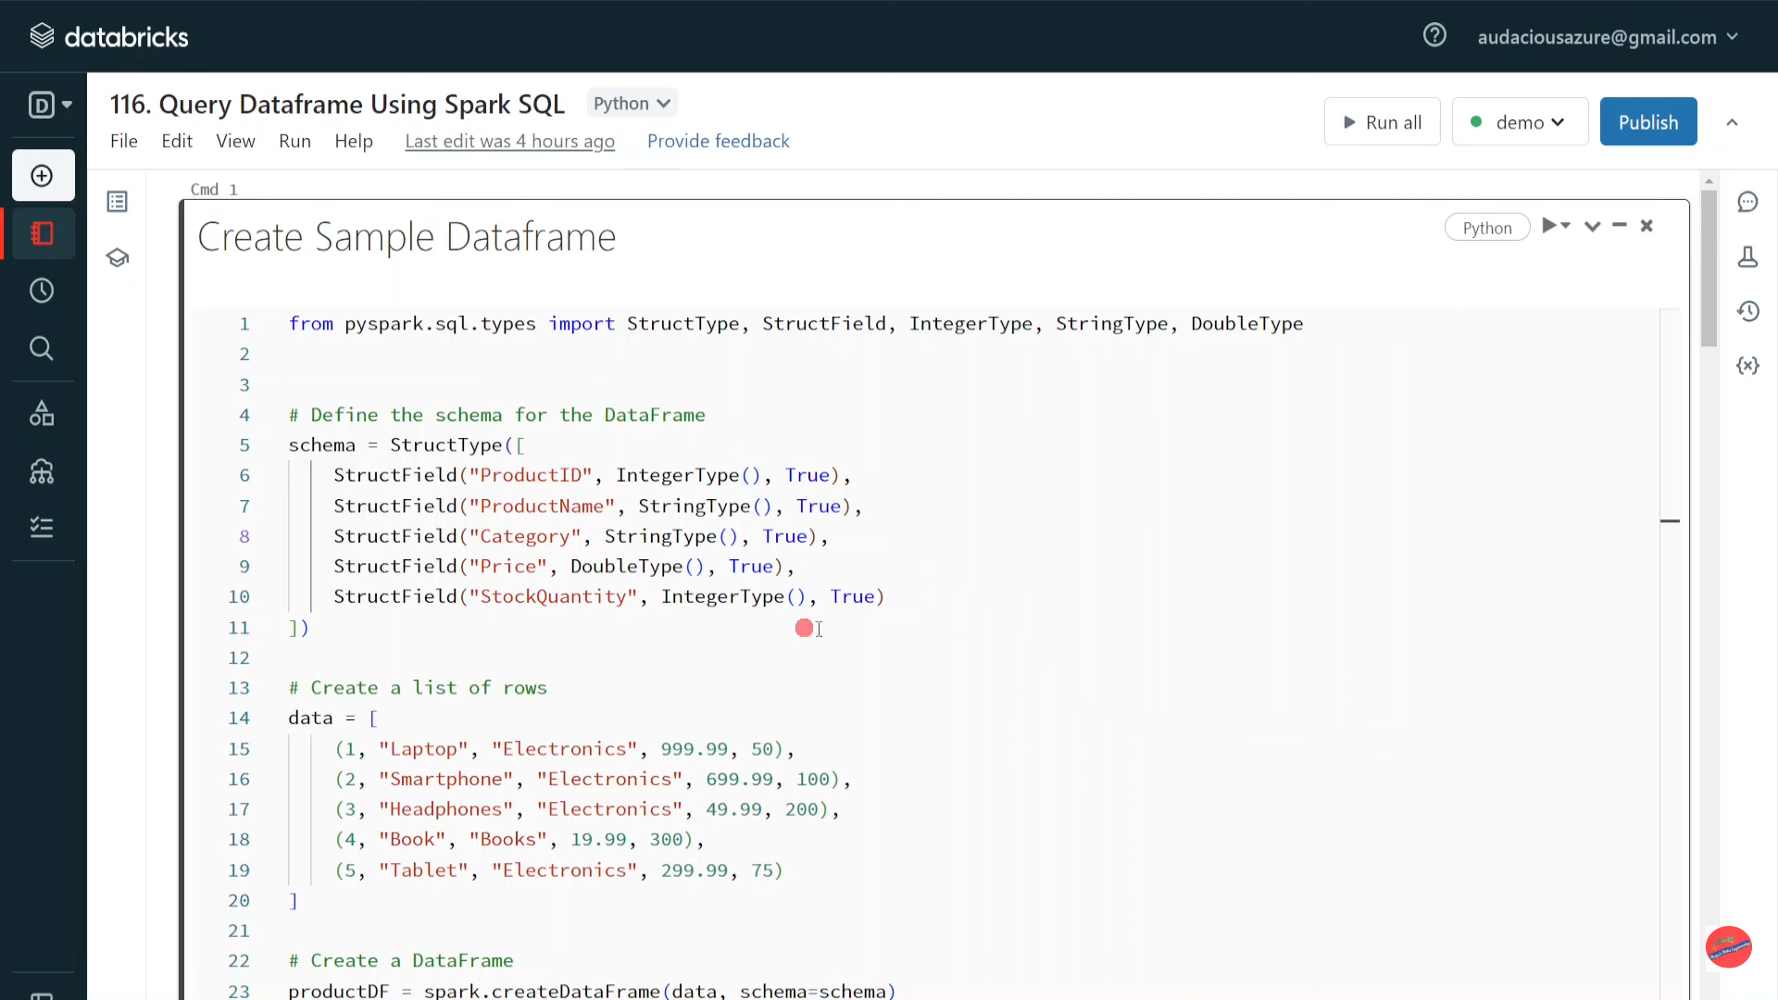

Slide 30
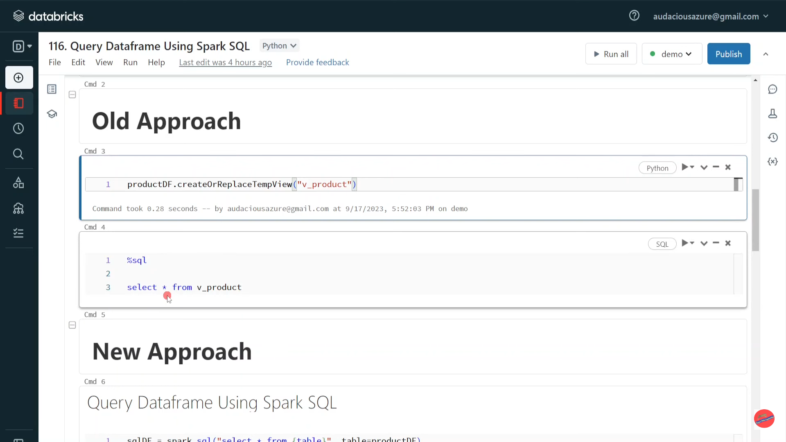

Slide 31
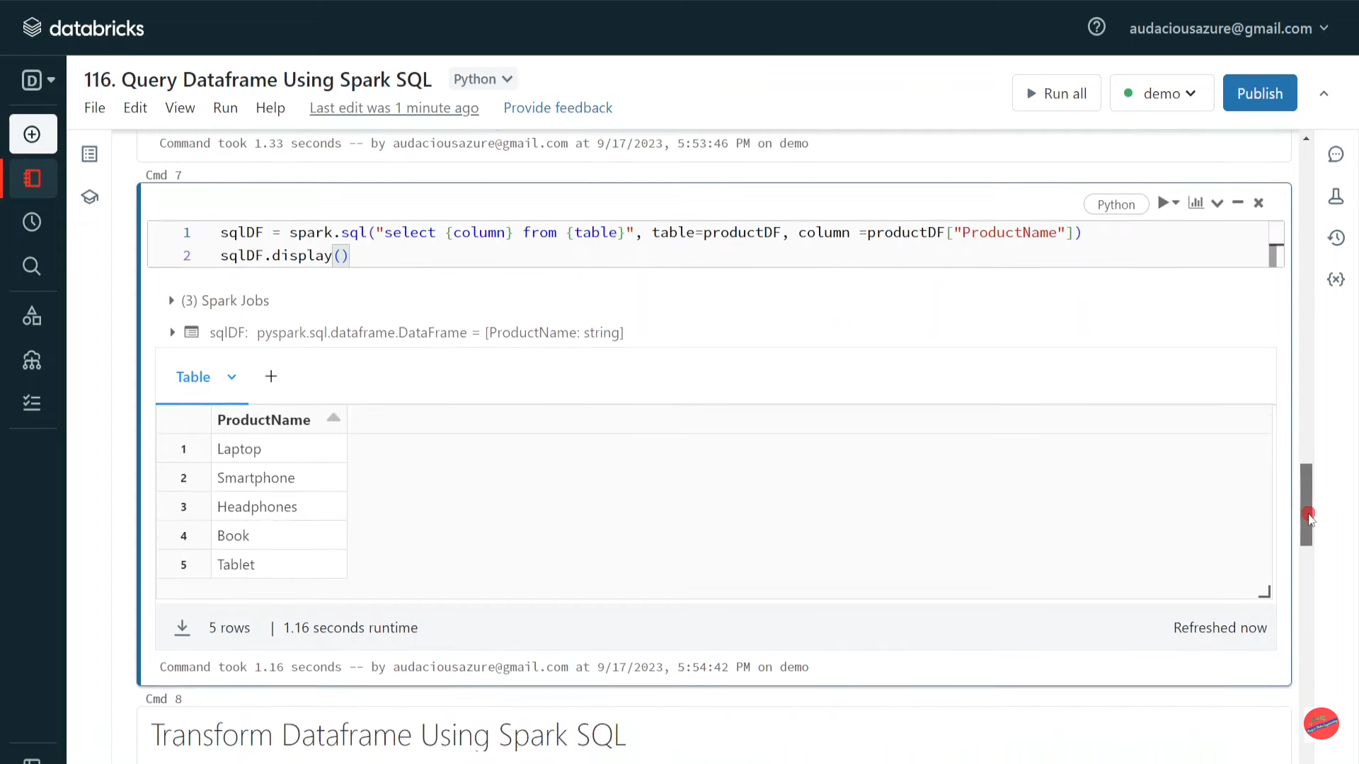

Slide 32
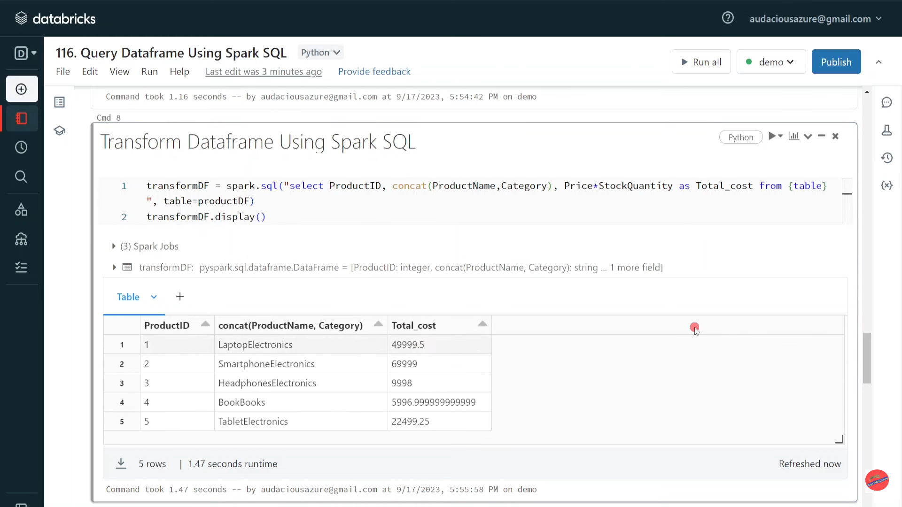

Slide 33
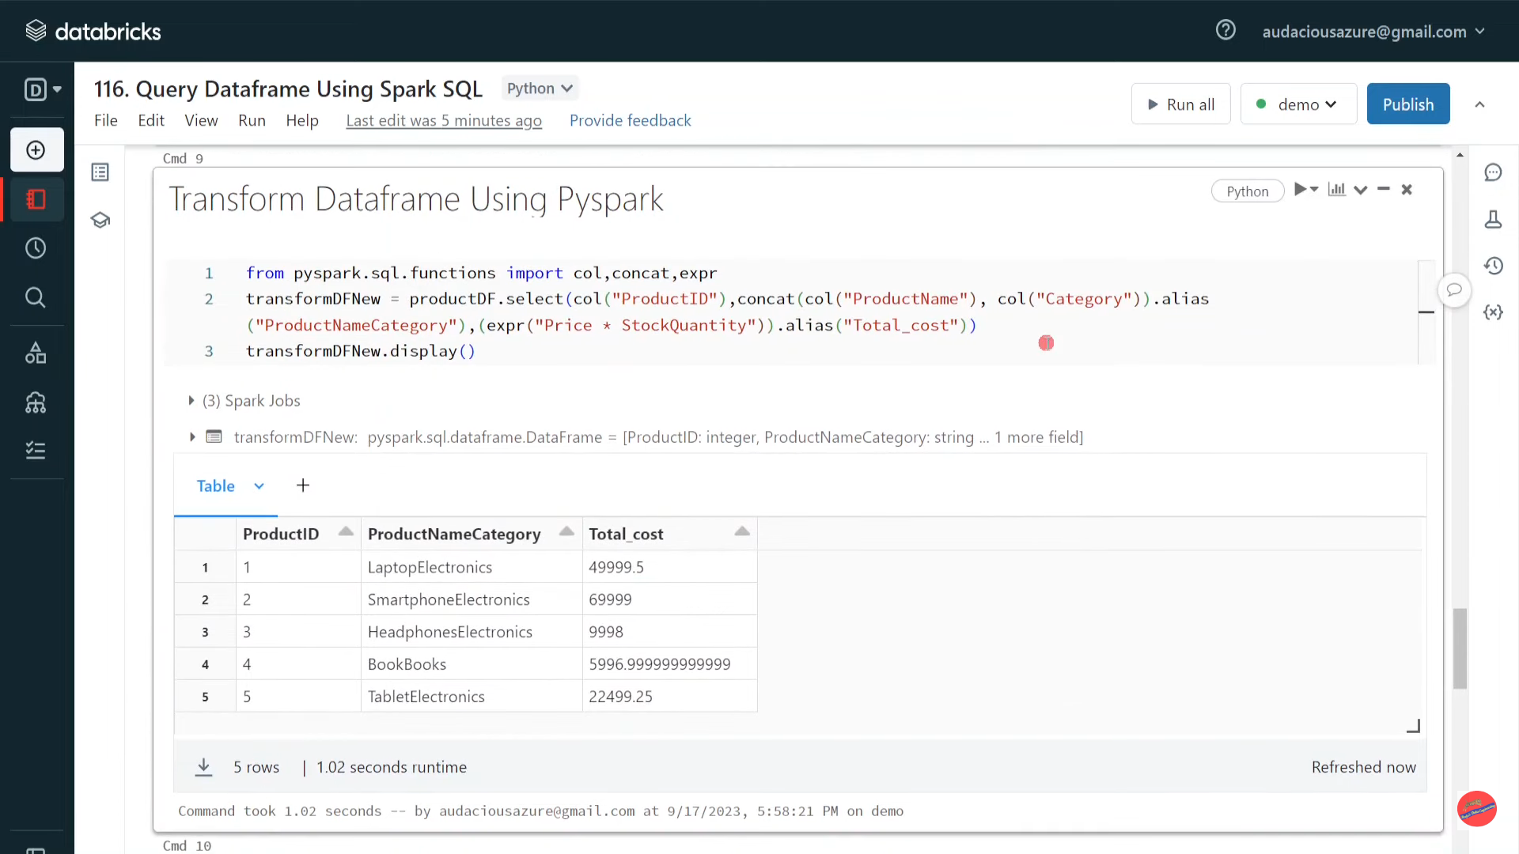

Slide 34
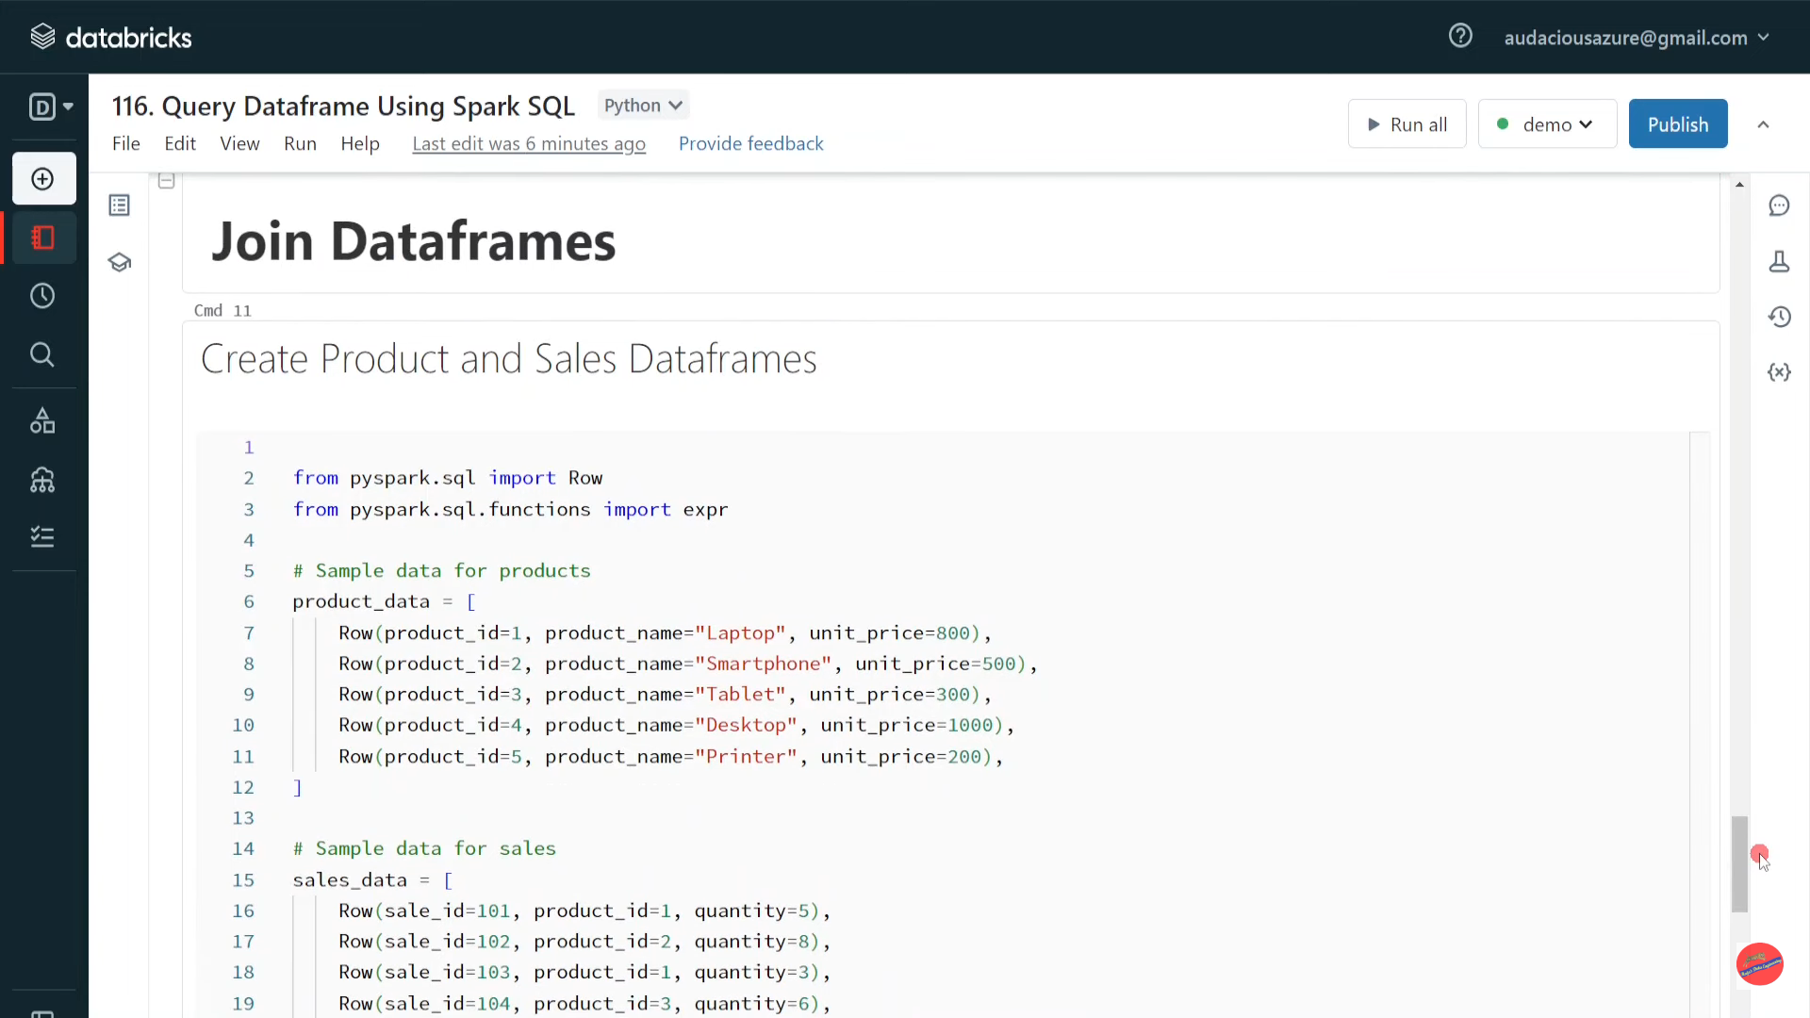

Slide 35
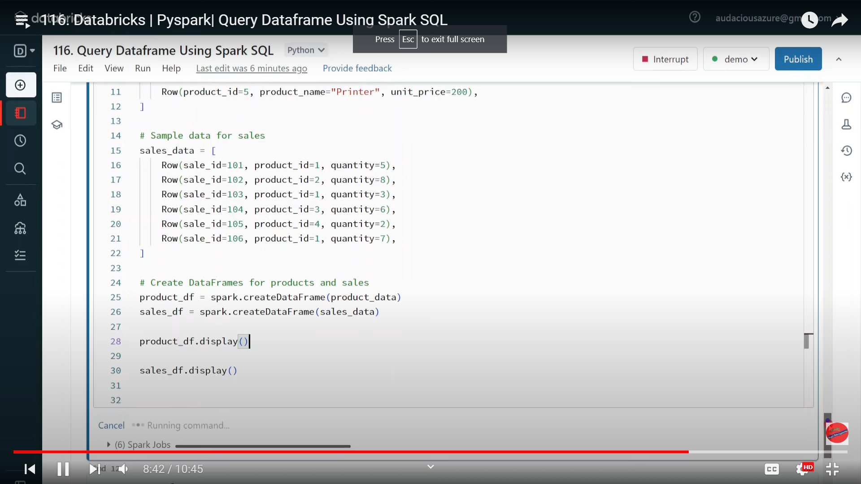

Slide 36
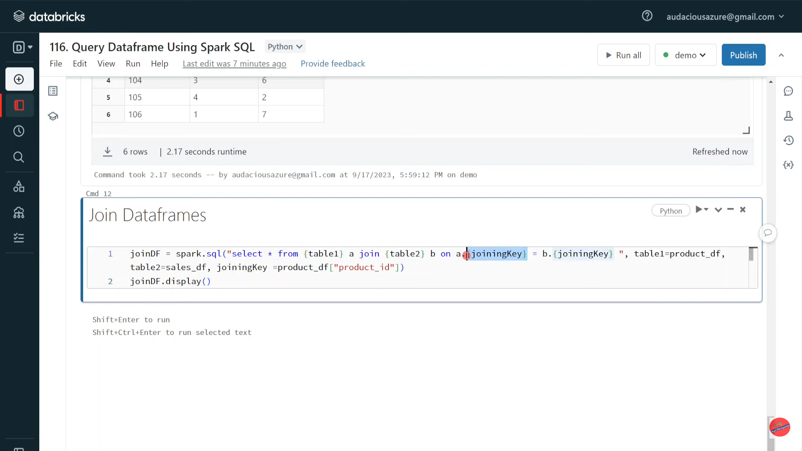

Slide 37
Databricks | Pyspark| Spark SQL: Except Columns in Select Clause

Slide 38
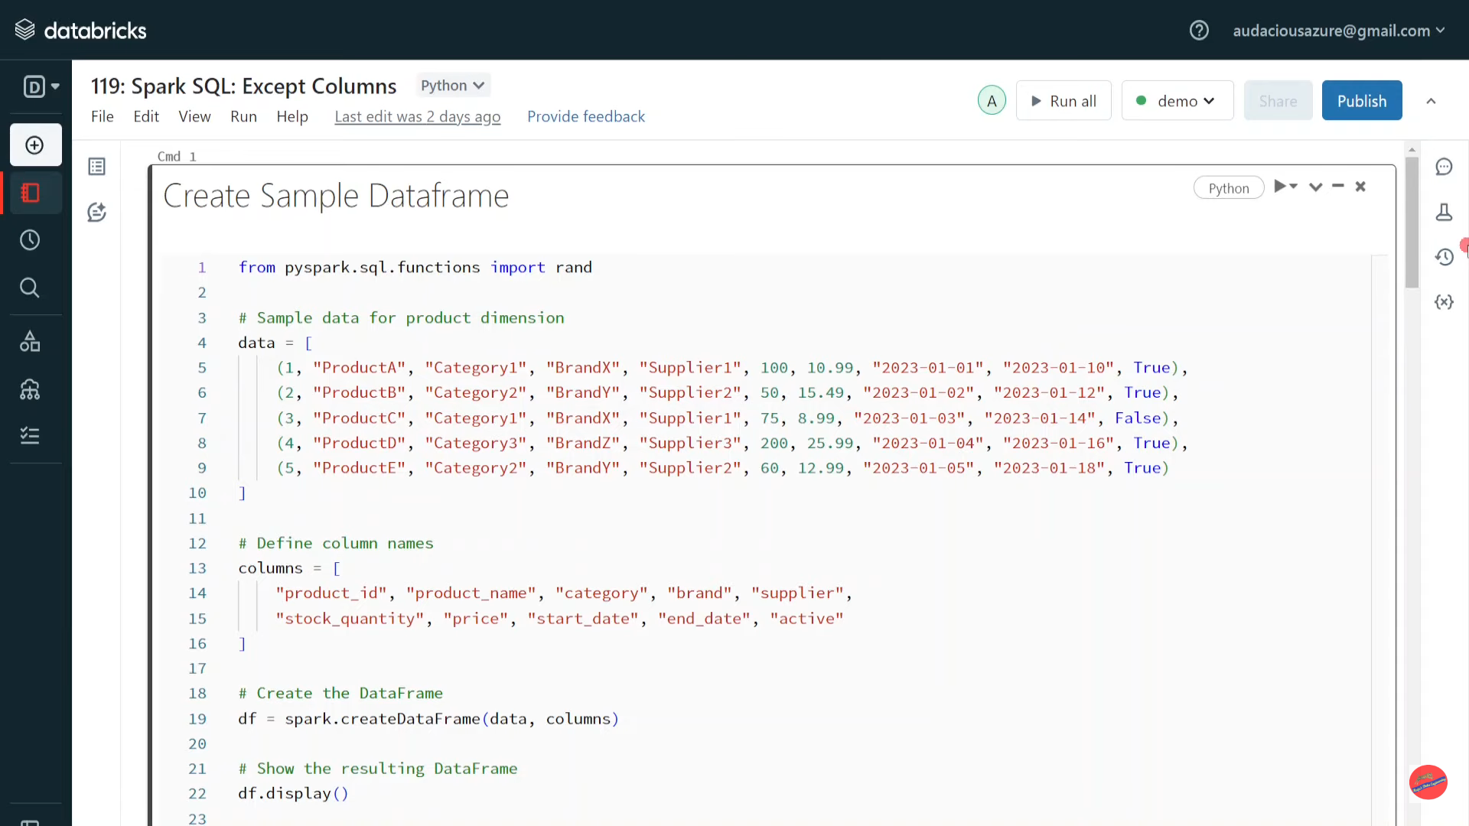

Slide 39
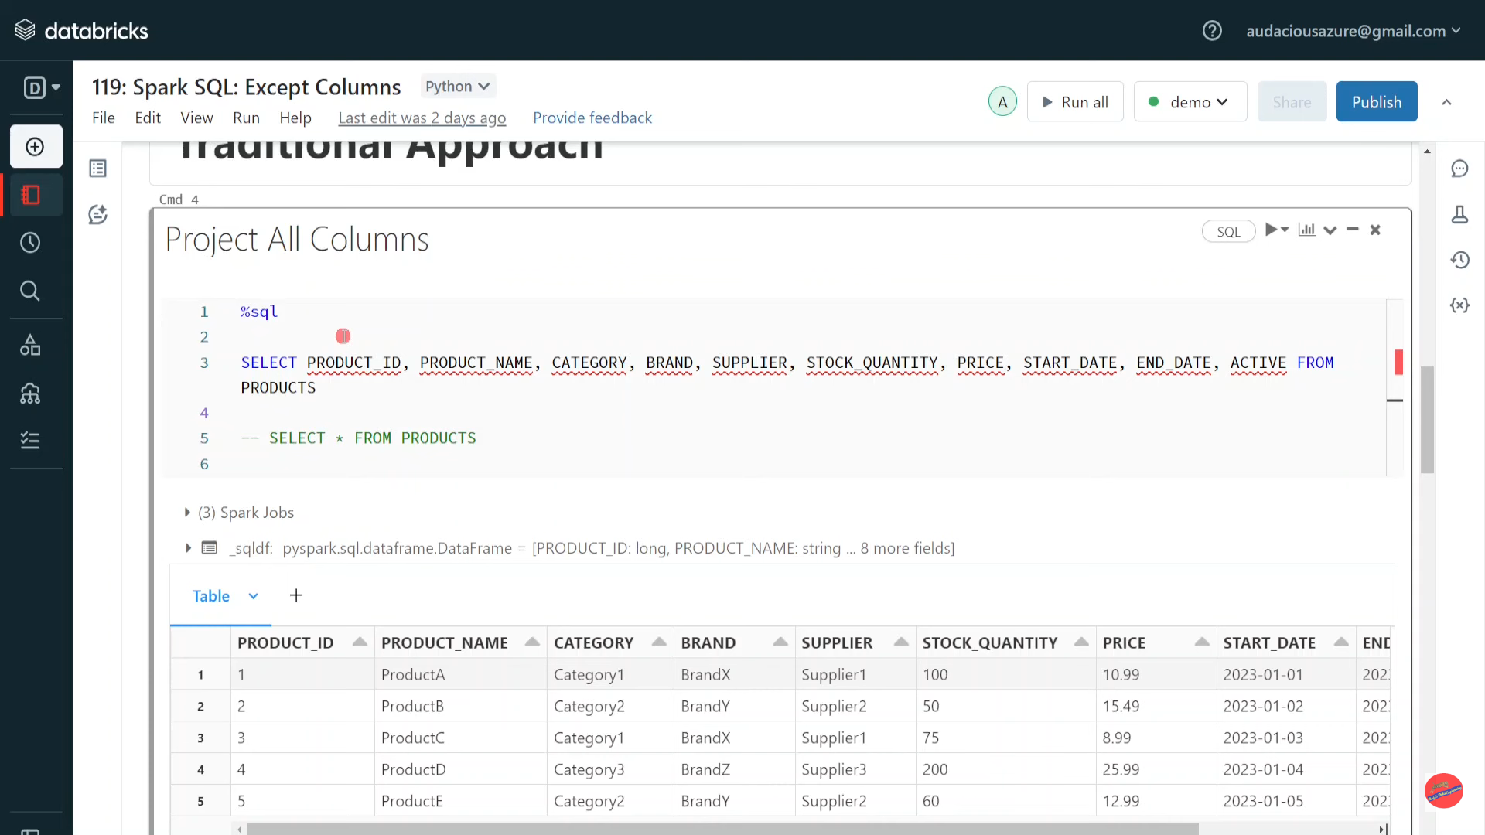

Slide 40
